Slide 1

Comparative Evaluation of Constrained and Unconstrained Deep Reinforcement Learning for Safe Robotic Grasping on a UR5e Manipulator in Simulation
Date of defense: 08 August, 2026
Presented by,
MD ABDUR RABBI
Roll: 2031023
Supervised by,
Priyo Nath Roy
Assistant Professor
Dept. of Mechatronics Engineering
Khulna University of Engineering & Technology, Khulna

Slide 2
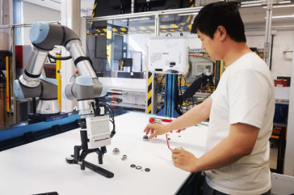
Introduction:
UR5: A collaborative arm that shares space with people
6-DOF, 5 kg payload, 850 mm reach
Max joint velocity 180 deg/s (𝜋 rad/s)
with ±360° working limit
Works next to people, not behind a fence
We use Reinforcement Learning (RL) to train robots

Slide 3
Background:
Reward shapes Policy but Constrains add safety with consistency
A learned policy can't be inspected like a hand-coded controller — its behaviour is only known statistically.
Safety on this class of arm is already an active industrial requirement, not a hypothetical
Validated only by trial and error, after the fact
This thesis tests the alternative: pull safety out of the reward
Let’s not just train a polity based on reward and penalty - start adding constraints

Slide 4
Literature Review:
Positioning Against the Closest Work
Property | Khan et al. | Shen et al. | This thesis
Manipulator | Franka Panda | 4-DOF planar | UR5e
Safety expressed as | Constraint | Reward term | Constraint
Safety quantity | Collision cost | Manipulability | Manipulability + joint limit + collision
Algorithm | PPO-Lagrangian | SAC (unconstrained) | PPO-Lagrangian
Control arm | ✗ | ✗ | ✓
Seed dispersion reported | ✗ | ✓ (5 seeds) | ✓ (5 seeds)
Cost Limit (d) | ✗ (d=25 only) | n/a | ✓ (d=25 and d=15)

Slide 5
Research Gap:
Three gaps in the closest published work and the design response
Gap | What the literature does | This thesis's response
No control arm | Trains cPPO vs. PPO, reports the raw difference | Control arm with λ pinned to zero — measures the implementation term directly
No dispersion | Mostly use only 1 seed | 5 seeds for training, 3 for evaluation
One budget only | Fixes cost limit (d) = 25 only | Used cost limit d = 25 & 15 effect read against how hard the constraint
3 concrete gaps in the literature and our response to each: no control arm -- we add one; no dispersion -- we report five-seed spreads; one budget -- we test two.

Slide 6
Objectives:
The main objectives of this thesis are,
Implementing both the constrained and unconstrained agents
Isolate the constraint as a cost critic with lambda as a Lagrangian multiplier
Use different seeds both for training and evaluation
Does a stated budget change safety behaviour — and its predictability?

Slide 7
Methodology:
TASK: Pick a cube, lift it, and hold it to the target position
Isaac Sim 5.0 + Isaac Lab 2.3.1
With False gripper action
Parallel envs: 4096, 1500 iterations per run
Object pose is given directly, not from vision
Episode: 5.0 s
PPO---cPPO(d=25)----cPPO(d=15)
SAFETY COST — 3 TERMS, 1 BUDGET
3 ARMS × 5 SEEDS = 15 TRAINED POLICIES
Term | Threshold | Status
Collision keep-out | 5 cm above table | monitored, inactive
Joint-limit margin | 0.175 rad (10°) | active
Singularity floor | w < 0.06 | active
Arm | cost_limit | λmax
PPO (baseline) | 25 | 0
cPPO, d = 25 | 25 | 100
cPPO, d = 15 | 15 | 100

Slide 8
Methodology:
PPO → PPO-LAGRANGIAN
PPO-Lagrangian adds one term: a cost critic estimates constraint violation, and a Lagrange multiplier λ trades reward against it — rising while over budget, settling once within it.
Same network, same hyperparameters, same environment — only the constraint differs across all three arms.

Slide 9
RESULT:
Mean Reward:
Lifting-object reward:
PPO(baseline) :
cPPO(d=25) :
cPPO(d=15) :
133.06
132.18
134.09
9.467
9.437
9.441
PPO (baseline)
cPPO (d = 25)
cPPO (d = 15)
(a) Singularity
(b) Joint limit
(c) Collision
0.08
0.4
0.0006
0.06
0.3
Cost contribution
0.04
0.0004
0.2
0.1
0.02
0.0002
0.0
0.00
0.0000
0
500
1000
1500
0
500
1000
1500
0
500
1000
Training iteration
Training iteration
Training iteration

Slide 10
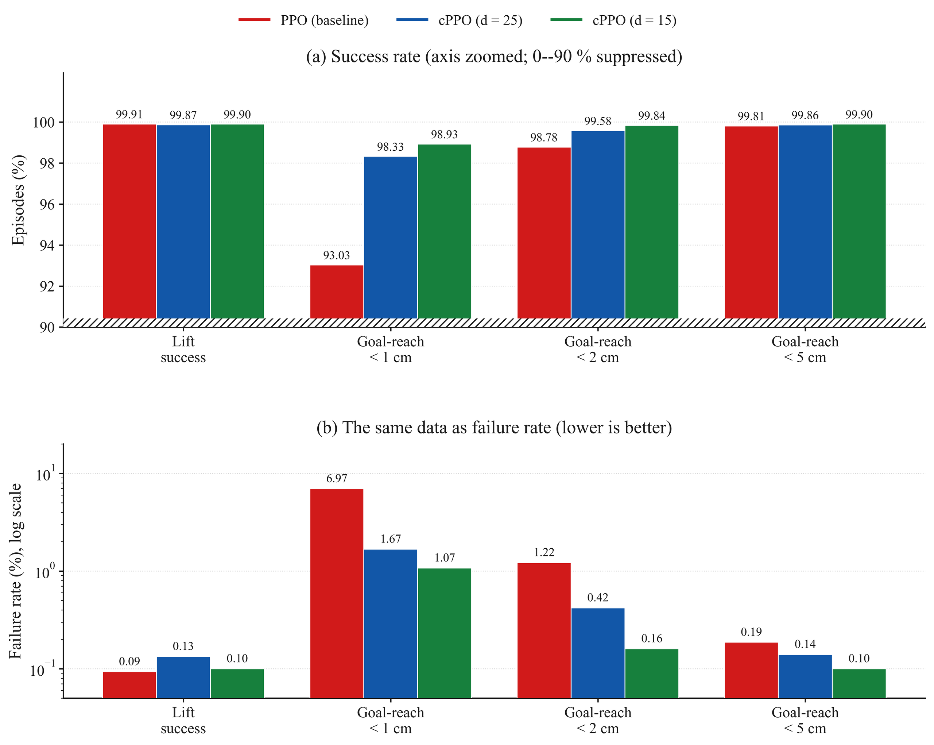
RESULT:
The constraint costs nothing measurable
Constraining the policy did not cost task performance at either budget.
*Tail mean(last 10% of the training data)

Slide 11
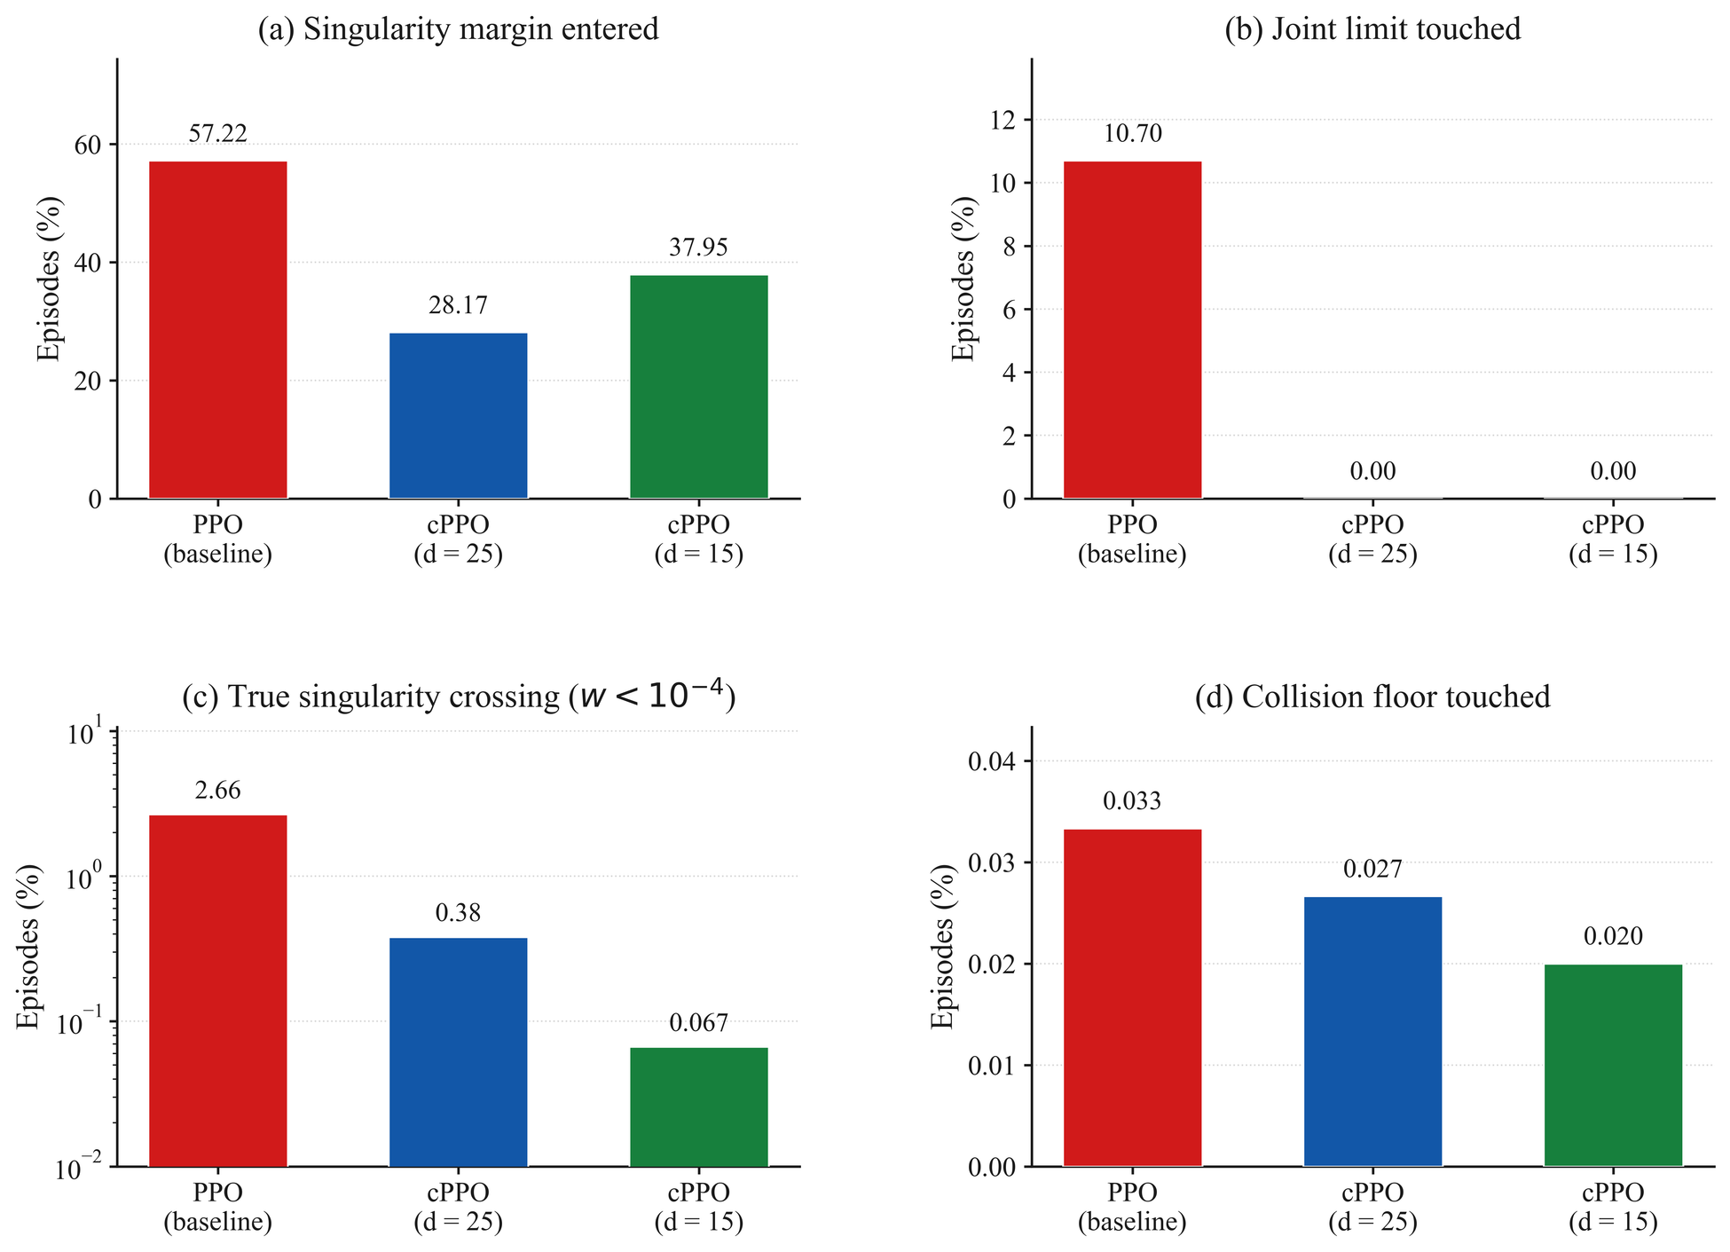
RESULT:
Safety: fewer true singularities, zero joint-limit contact

Slide 12
Conclusion:
A stated budget changes what a policy does — mostly by making it predictable
Constraining the policy reduces unsafe behaviour
At no measurable task cost.
An unanticipated effect is on consistency
Future Work:
IBVS systems
Sim-to-real application
PID Lagrangian
More Seeds implementations

Slide 13
Key Resources:
[1] Altman, E. (1999). Constrained Markov Decision Processes. Chapman & Hall/CRC.
[2] Schulman, J. et al. (2017). Proximal Policy Optimization Algorithms. arXiv:1707.06347.
[3] Achiam, J. et al. (2017). Constrained Policy Optimization. Proc. ICML, PMLR 70.
[4] Ray, A., Achiam, J., & Amodei, D. (2019). Benchmarking Safe Exploration in Deep RL. OpenAI.
[5] Stooke, A., Achiam, J., & Abbeel, P. (2020). Responsive Safety in RL by PID Lagrangian Methods. Proc. ICML, PMLR 119.
[6] Yoshikawa, T. (1985). Manipulability of Robotic Mechanisms. Int. J. Robotics Research, 4(2).
[7] Henderson, P. et al. (2018). Deep Reinforcement Learning That Matters. Proc. AAAI 32(1).
[8] Khan, F. et al. (2026). RL for Precision Grasping and Safety-Critical Coordination in a Robotic Arm. Intelligent Service Robotics, 19(16).
[9] Shen, Y. et al. (2022). RL-Based Reactive Obstacle Avoidance for Redundant Manipulators. Entropy, 24(2).

Slide 14
Key Resources:
[10] Ferreira, H. C. & Barbosa, R. S. (2025). Deep RL for Adaptive Robotic Grasping in Simulated Dynamic Environments. Future Internet, 17(10).
[11] Shahid, A. A. et al. (2022). Continuous Control Actions Learning and Adaptation for Robotic Manipulation through RL. Autonomous Robots, 46.
[12] Mittal, M. et al. (2023). Orbit: A Unified Simulation Framework for Interactive Robot Learning Environments. IEEE RA-L, 8(6).
[13] Rudin, N. et al. (2022). Learning to Walk in Minutes Using Massively Parallel Deep RL. Proc. CoRL, PMLR
[14] Universal Robots A/S (2023). UR5e Technical Specifications. Product datasheet.
[15] Khan, M. M. (2025). Enhancing Manipulator Control Through IBVS Techniques Using ROS2. BSc thesis, KUET.

Slide 15
THANK YOU

